Slide 1
How accurate are weather forecasts for cities in different regions of the United States?
Project done by: Celia Morse
Data sourced from: USA National Weather Service by Shreyas Bhavanasi, Harrison Lanier, Lauren Schmiedeler, and Clayton Strauch

Slide 2
Introduction: Why is This Important?
The world's climate has been changing rapidly over the last few decades…
An analysis on this can provide:
A better understanding of how different geographical factors affect climate.
But why is this important?
Identifying these relationships can help develop a better understanding of how the changing climate affects different regions and prepare for potential impacts!

Slide 3
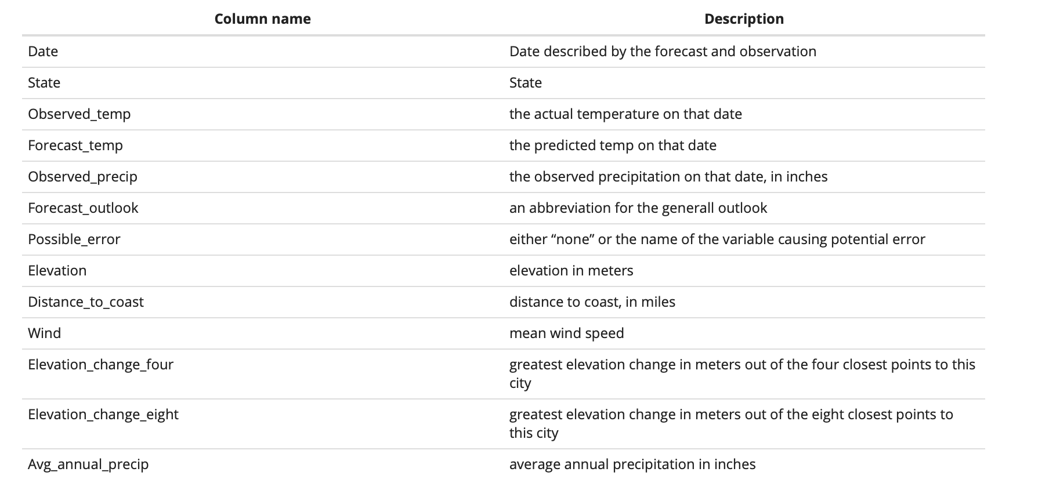
About this Data

Slide 4
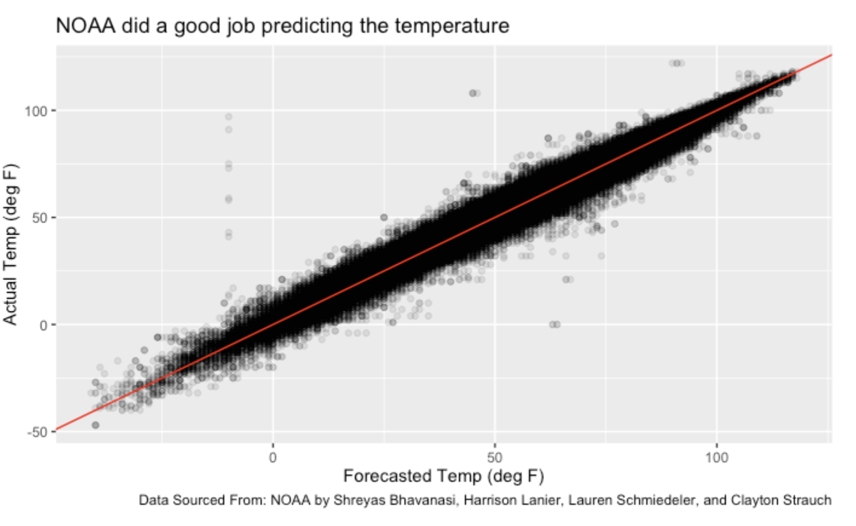
Starting Off: What Is the Story?
Although we really don’t know how the NOAA made their predictions…
We can see they did a good job given the differences between actual and forecasted temperatures are small.
The visualization to the right shows a perfect prediction along the red line.
21°C 15°C | 24°C 21°C | 23°C 19°C | 21°C 18°C | 19°C 14°C | 20°C 17°C | 18°C 16°C

Slide 5
Investigation and Statistical Measures
Mean Absolute Error(MAE)
Root Mean Squared Error (RMSE)
What is MAE?
What is RMSE?
In this case…
On the other hand…
MAE tells us on average how far off the weather forecasts are from the actual values.
RMSE measures the deviation of the predictions from the actual values.
Small MAE means forecasted values are close to the actual values
If the RMSE is small, it indicates that the forecast errors tend to be small as well.
2 pm | 22°C
4 pm | 18°C

Slide 6
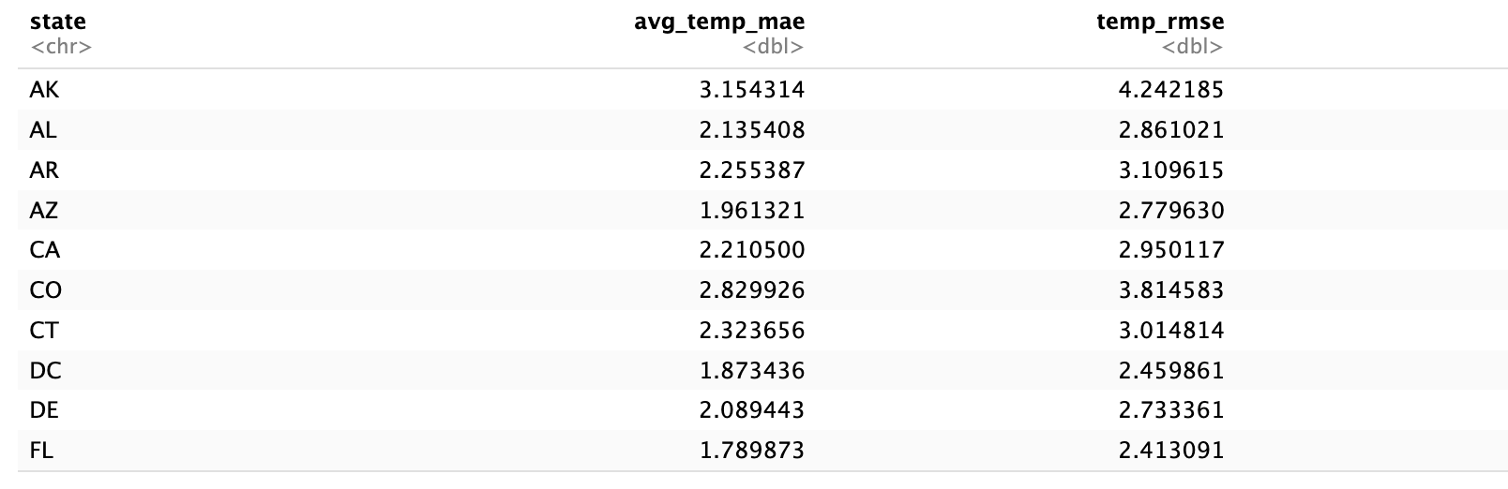
How is this done?
I took the difference between the predicted values and the actual values of temperature, and then took the average of these differences.
My results show MT has the largest MAE and FL has the smallest MAE.
Now let’s think…
FL and MT are very geographically different states.
Could this be investigated further?

Slide 7
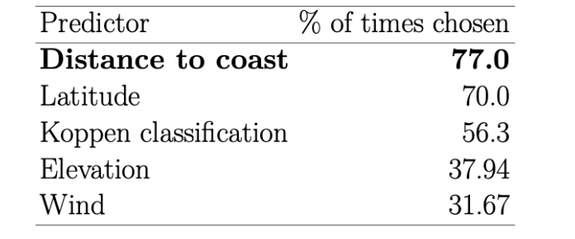
Further Investigation
Research on this data allowed me to determine that the distance_to_coast variable is an important feature in predicting weather forecast accuracy.
Florida is a coastal state, and MT is landlocked which may provide explanation on their MAE.

Slide 8
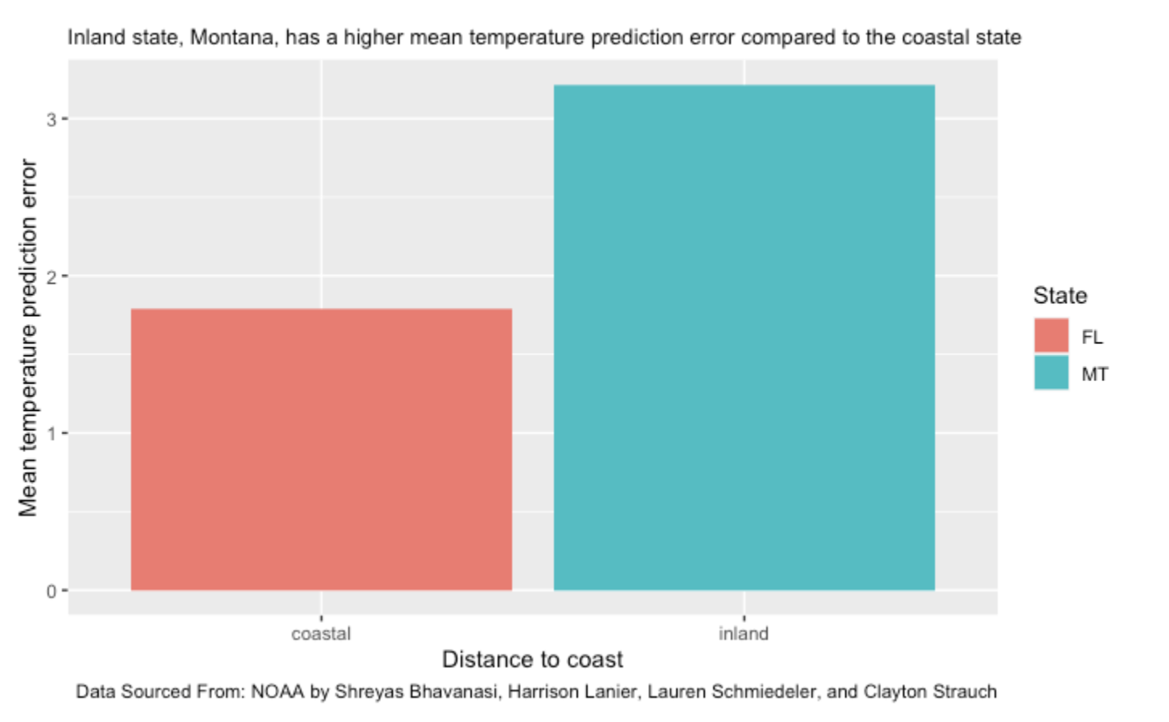
Further Investigation
Finally, I looked at the mean temperature prediction error based on distance to the coast for both states.
These results suggest that inland regions may be more challenging to predict accurately.
Possible Explanations:
Coastal areas generally experience more consistent weather patterns
Coastal regions are more likely to be influenced by ocean currents
Coastal areas may have more weather monitoring stations compared to inland regions.

Slide 9
Conclusion
The results suggest that distance to the coast is an important factor to consider when predicting temperature forecast errors
MAE could be a useful metric for evaluating the accuracy of weather forecasts.
This dataset can be further analyzed to gain better insights and understanding of the data it contains.
50%
60%
75%
45%
60%
30%
10%

Slide 10
The End: Thank You!
Works Cited
Rfordatascience. “Tidytuesday/Data/2022/2022-12-20 at Master · Rfordatascience/Tidytuesday.” GitHub, github.com/rfordatascience/tidytuesday/tree/master/data/2022/2022-12-20. Accessed 9 May 2023.
US Department of Commerce, NOAA. National Weather Service, www.weather.gov/. Accessed 9 May 2023.

